Slide 1
Income Prediction Project Presentation
Leveraging Data to Predict Income Thresholds

Slide 2
Stakeholders and Problem Statement
The goal of this project is to predict whether an individual's income is above or below a certain threshold.
The stakeholders include organizations or individuals who are interested in understanding the factors that influence an individual's income and want to use this prediction for decision-making.

Slide 3
Data Overview
The dataset includes various features such as education level, age, gender, occupation, and more, which are believed to influence an individual's income.
The target variable is whether the income is above or below a threshold.
Source of data:
The data can be downloaded from Data Dictionary

Slide 4
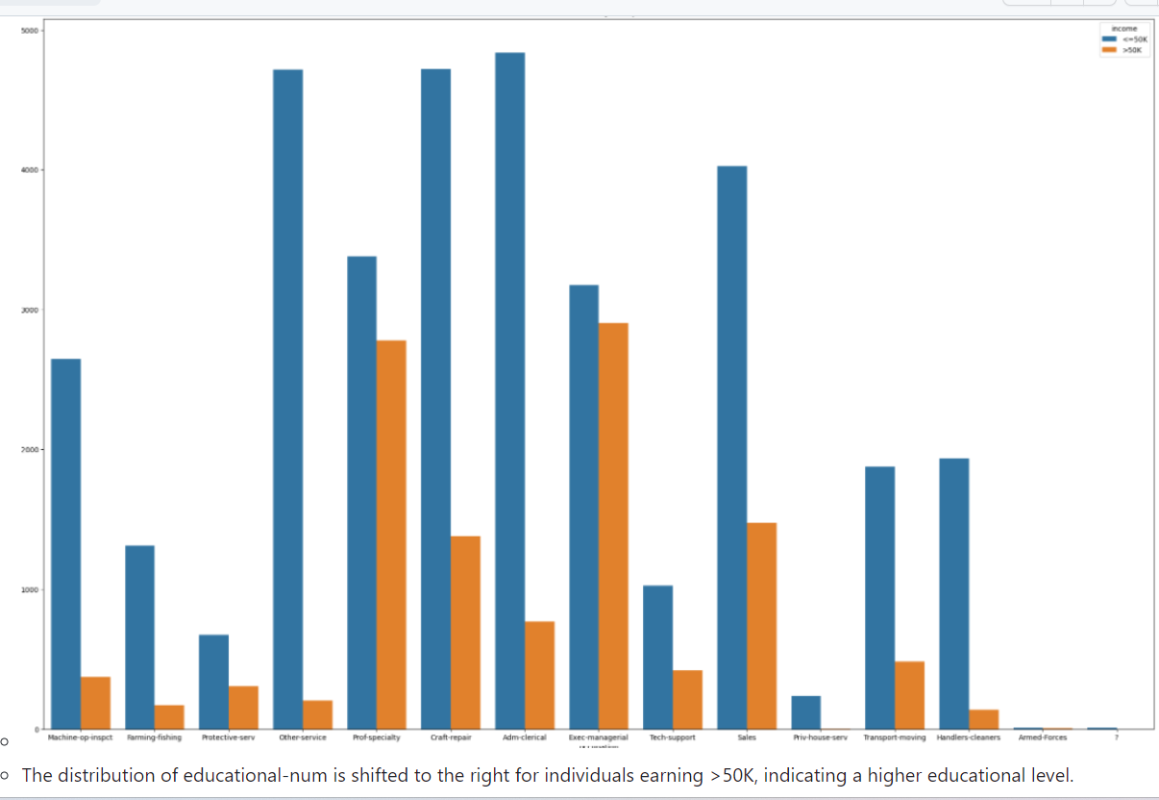
Key Finding 1
Education Matters: Higher Education Drives Income: Those with advanced education are more likely to earn over $50K
annually.

Slide 5
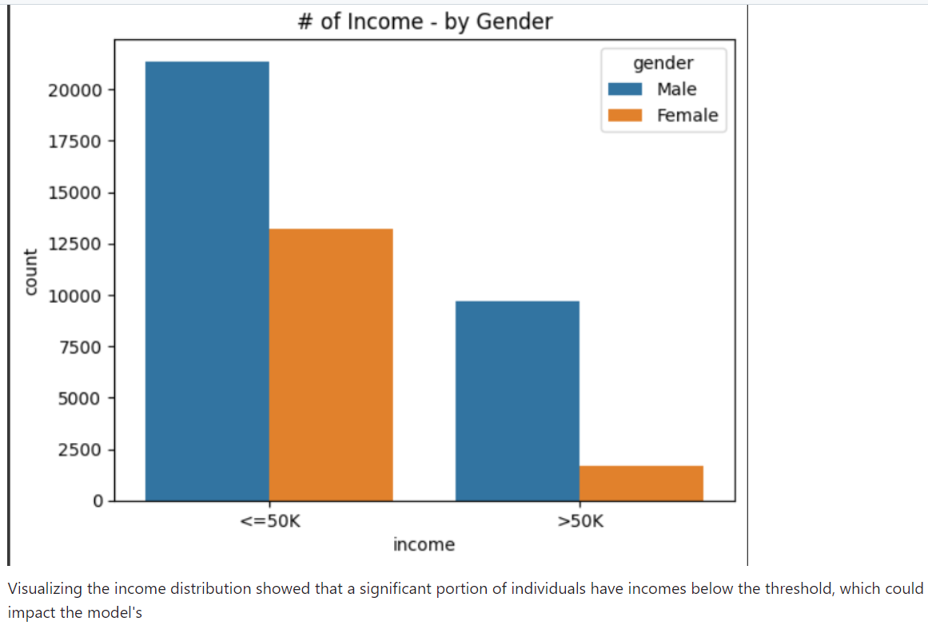
Key Finding 2
Age and Income: Among males, higher age is associated with incomes below $50K

Slide 6
Model Performance
DecisionTreeClassifier
Training Data:
Accuracy: 1.00
Test Data:
Accuracy: 0.81
LogisticRegression
Training Data:
Accuracy: 0.85
Test Data:
Accuracy: 0.85
Model with PCA (Logistic Regression)
Training Data:
Accuracy: 0.83
Test Data:
Accuracy: 0.84

Slide 7
Model Evaluation
Decision Tree Model:
Training Data: Imagine teaching a robot to do a task perfectly when it already knows all the answers. It gets everything right in practice (100%).
Test Data: But when the robot faces new questions it hasn't seen before, it doesn't do as well (81%). It's like a student who aces homework but struggles on a surprise test.
LogisticRegression Model:
Training Data: This model is like a student who studies and scores 85% on practice questions.
Test Data: When faced with new questions, it still gets 85% correct. So, it's consistent and reliable.
PCA Model with Logistic Regression:
Training Data: Here, it's like a student who scores 83% on practice questions.
Test Data: When given new questions, this student gets 84% correct. So, it's pretty good at handling surprises.

Slide 8
Which Model
Our main aim is to have a model that works well with new, unknown data. So, we want a model that's like a good student, performing consistently well in real-world situations.
Considering this, the LogisticRegression model is our best pick. It's like a dependable friend who's good at handling both practice and real-life challenges. It's a safe bet for solving our income prediction problem effectively.

Slide 9
Recommendations
Investing in Education
- One standout factor is education. It's like the key ingredient in a successful dish. So, consider investing in educational programs to help people improve their skills and potentially earn more.
Targeting the Right Age Group
- We've also pinpointed an age range where people are more likely to earn higher incomes. It's like knowing the right audience for a product. You can focus your efforts on providing them with financial products or services tailored to their needs.

Slide 10
Conclusion
This project aimed to predict an individual's income using various features from the Adult Income Dataset.
The analysis provided insights into the relationships between features and income, and the predictive models helped in achieving accurate income predictions.
The recommendations provided can guide stakeholders in making informed decisions to address income-related challenges.

Slide 11
Q&A

